Slide 1
Basics of Ayurved and Ritucharya आयुर्वेद एवं ऋतुचर्या
Presentation by Anil Chawla
1st April 2014
www.samarthbharat.com
Note: Ayurved is the ancient system of medicine practiced for thousands of years in India. Ayurved lays great stress on ritucharya, which means rules for living as per demands of changing seasons.
Copyright – All Rights Free

Slide 2
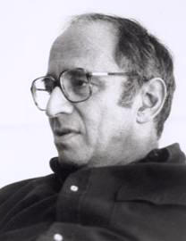
Paradigm
A typical example or pattern of something; a pattern or model
Thomas Kuhn - the set of practices that define a scientific discipline at any particular period of time; Basic assumptions, principles, methods and techniques
T. Kuhn - provide model problems and solutions for a community of practitioners

Slide 3
Advantages of Paradigm
Convenient
Allows scientists to agree on the basics of the subject and discuss only the details
All science, therefore, is puzzle-solving within the four walls of a paradigm
Purpose of most science is NOT discovery of truth but solving a jigsaw puzzle as per the picture provided.

Slide 4
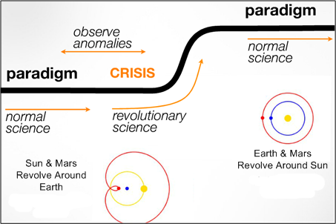
Scientific Growth Process

Slide 5
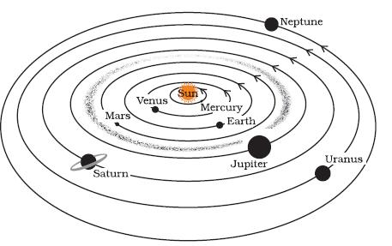
Example 1 of Paradigm – Solar System
This is view from a hypothetical distant star which no one has ever visited.

Slide 6
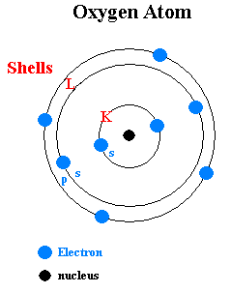
Example 2 – Internal Structure of Atom

Slide 7
Example 3 – Law of Gravitation
Any two bodies in the universe attract each other with a force that is directly proportional to the product of their masses and inversely proportional to the square of the distance between them.
How do bodies calculate each other’s masses?
How do they measure distance?
Which part of an atom does this calculation?
Does it mean that each and every inanimate object is wiser than every living one including all human beings?

Slide 8
A Paradigm Teaches One to
Never ask any questions that challenge the paradigm
In general, second how and why are strictly forbidden
Everything within the four walls of the paradigm looks fine, while everything outside is ridiculed and laughed at as NON-SCIENTIFIC and Superstition. (No wonder that allopathic doctors make fun of ayurved)

Slide 9
Key Elements of Paradigm of Allopathy
Pasteurian Model – Disease caused by external agents (Germs / Bacteria / Virus); Mistake only of external agent and never of human being
Analytic-Mechanistic – Parts determine the whole; Ingredients-based approach
Bad road, poor vehicle makes a lot of noise; Solution – injection to remove misery of driver by making him temporarily deaf
Doctors and Pharmaceutical companies have a right to make profits from misery of patients – so goal is not health but removal of disease for a profit
Every unexplained phenomenon is either named an allergy or a syndrome

Slide 10
Problems with Pasteurian Model
Complete failure in case of non-infective diseases like hypertension, diabetes, heart trouble, prostate enlargement, spondylitis, arthritis, infertility, etc.
Present medical research knows how to deal with less than 0.01% of the pathogenic microbes.
Microbial world changes much faster than medical research. So new bacteria and virus etc. are causing new diseases which appear incurable.
Increasing resistance to antibiotics.
To sum up, human race has won a few battles but seems to be losing the war

Slide 11
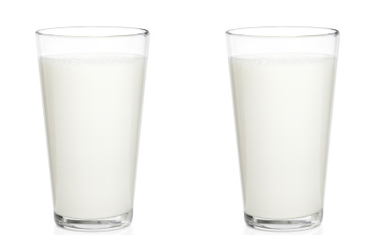
Problems with Ingredient Based Approach
Number of ingredients in any food are too numerous. So, broad generalizations are the norm.
Since allopathy does not view man as a complete being, each ingredient analyzed with reference to some body part or function.
Both glasses of milk are found 99.99% identical by a chemical laboratory. Which one will you drink? Hidden information – one glass has 0.01% Potassium Cyanide.

Slide 12
Ayurved Paradigm - Key Characteristics
Holistic समग्रतावादी, पूर्णतावादी – treats the whole body as one
Is not based on war with nature model; Harmony with nature
No separation between mind and body
Believes in creating health instead of only curing diseases
Considers every aspect of life including food, sleep, physical exercise, bath, exposure to sun, love and sex.
Making profit from misery is a sin – doctor benefits from good health and not from disease
Everything can be used as a medicine. Every food can be a medicine as well as a poison, depending on the quantity, time, method of consumption etc.

Slide 13
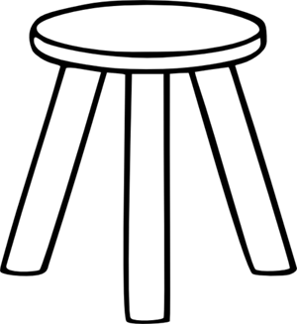
Vaat, Pitt and Kaph
Control Tools - Food
Six Ras
Sweet मधुर
Sour अम्ल
Salty लवण
Pungent तीखा
Bitter कड़वा
Astringent कसैला
Control – Non-Food
Physical Exercise
Bath
Massage
Laxative
Vomit
Inserting liquid through bottom orifice
Sleep
Sun
Medicine
Vaat वात
Kaph कफ
Pitt पित्त
Tridoshshamak (Control of all three) – Triphala, Bathua, Baal-Mooli त्रिफला, बथुआ, बाल-मूली
Tridoshkarak (Causes all three defects) – Beef, Sarson Ka Saag, Rajmah, Vridh-Mooli गोमांस, सरसों का साग, राजमाह, वृद्ध-मूली

Slide 14
Some Other Control Substances
Substance | Vaat | Pitt | Kaph
Ghee | Reduces | Reduces | Increases
Honey | Increases | Reduces | Reduces
Gingely / Sesame Oil तिल तेल | Reduces | Increases | Reduces
Meat of animals living in watery areas, aquatic creatures, animals living under ground and animals that snatch food (Wet Group Meats) | Reduces | Increases | Increases
Animals living in dry areas and some birds (Dry Group Meats) | Mild Reduction | Reduces | Increases

Slide 15
Functions of Vaat
Control of one’s emotions (मन को नियन्त्रित एवं प्रेरित करने वाला)
Inspiring senses (eyes, ears, tongue, skin, nose) to do their work (इन्द्रियों को अपने कार्य में प्रेरित करना)
Giving strength to appetite (जठराग्नि को प्रदीप्त करना)
Basis of all sensory knowledge (इन्द्रियार्थ ज्ञान का कारण)
Joining of bones, joints and muscles
Responsible for all types of movements – breath, spitting, urine, stool, sweat, semen, foetus, sneeze, yawn, food (थूकना, छींकना, जम्भाई, श्वास, अन्न का प्रवेश, मल, मूत्र, शुक्र, पसीना, शिशु)
Body movements
Enthusiasm, fear, confusion, depression, feeling of happiness, sadness (भय, शोक, मोह, हर्ष, उत्साह, दैन्य, अतिप्रलाप )

Slide 16
Functions of Pitt
Digestion / burning of food
Wisdom, Intellect, Ego, Sharpness, Enthusiasm, Achievement of objectives बुद्धि , मेधा , अभिमान , उत्साह , अर्थ-सिद्धि
Ability to appreciate beauty
Makes skin glowing

Slide 17
Functions of kaph
Moistening
Softening
Lubrication of eyes
Lubrication of joints
Feeling of being satiated or happy सुख अनुभूति

Slide 18
Qualities of Vaat
Dry / rough रूक्ष
Cold शीत
Light लघु
Fine सूक्ष्म
Mobile चल
Non-sliminess विशद
Hard दारुण
Porous शुषिर

Slide 19
Qualities of Pitt
Warm ऊष्ण
Sharp तीक्ष्ण
Liquid द्रव
Acidic अम्ल
Mobile सर
Pungent कटु
Foul Smell दुर्गन्धयुक्त

Slide 20
Qualities of Kaph
Heavy गुरु
Cold शीत
Soft मृदु
Oily चिकना स्निग्ध
Sticky पिच्छिल चिपचिपा
Sweet मधुर
Stationary / Immobile स्थिर

Slide 21
Dosh and Six Ras
Dosh | Increase |  |  | Decrease
Vaat | Pungent तीखा | Bitter कड़वा | Astringent कसैला | Sweet मधुर | Sour खट्टा | Salty नमकीन
Pitt | Pungent तीखा | Sour खट्टा | Salty नमकीन | Sweet मधुर | Bitter कड़वा | Astringent कसैला
Kaph | Sweet मधुर | Sour खट्टा | Salty नमकीन | Pungent तीखा | Bitter कड़वा | Astringent कसैला

Slide 22
When & Where Prominent
 | Vaat | Pitt | Kaph
Body | Below heart and navel | Between heart and navel | Above heart and navel
Age | Above 40 | 20 to 40 | Below 20
Day | 2 pm – 6 pm | 10 am – 2 pm | 6 am – 10 am
Night | 2 am – 6 am | 10 pm – 2 am | 6 pm – 10 pm
Digestion Period | At the end | Mid-period | Start
Increased by | Worries, Sadness, Remaining awake late night | Anger, Sun | Sleeping during day
Nature | Air | Sun | Moon

Slide 23
Some More Characteristics of Vaat etc.
 | Vaat | Pitt | Kaph
Stool मल | Cruel क्रूर | Semi-formed मृदु | Medium, well-formed मध्यकोष्ठ
Appetite अग्नि | Disturbed विषम | Sharp तीक्ष्ण | Low मंद
Symptoms | Yawn | Burning sensation | Sleepiness
Key extracting method | Insertion of liquid through bottom वस्तिकर्म | Laxative विरेचन | Vomit वमन
Key control medicine | Sesame Oil तिल तेल | Ghee घी | Honey मधु

Slide 24
Characteristics of a Few Foods
Ginger – Pungent yet reduces both vaat and kaph
Asafoetida हींग – Increases appetite, reduces vaat and kaph
Honey, Jau जौ and wheat – sweet but do not increase kaph
Jau जौ – Increases quantity of stools; dry, cold, increases vaat, reduces kaph, strength building
Alcohol – bitter but being acid effect is acidic; causes increase of pitt; makes body weak when consumed wrongly, but healthy when consumed in proper quantity and at proper season
Amla – Best for longevity, has five ras (all except salt), cold hence not consumed in the season when it is produced

Slide 25
Characteristics of a Few Daal (दाल)
Moong मूंग – Sweet, Astringent, cold, light, reduces pitt and kaph
Urad उड़द – Very good for reducing vaat, increases pitt and kaph, warm, heavy to digest, strength-giving, increases sexual ability
Kulathi कुलथी – Warm, Best in increasing pitt, Destroys vaat and kaph, Binds stools, Useful in all vaat diseases, binds stools
Moth मोठ – Sweet but not oily, cold, causes constipation, dry, cold, useful for pitt diseases and fever
Arhar अरहर, तुअर, तूर – Increases vaat, reduces pitt and kaph
Masoor मसूर – Cold, sweet, slightly astringent, good when pitt and kaph are high, binds stools

Slide 26
Two Parts of a Year
 | Aadan (Weakening) आदान | Visarg (Strengthening) विसर्ग
Sun | Northward उत्तरायण | Southward दक्षिणायन
Season | Shishir, Vasant, Greeshm शिशिर, वसंत, ग्रीष्म | Varsha, Sharad, Hemant वर्षा, शरद, हेमंत
Air | Extremely Dry | Not Dry
Nature | Prominence of Fire element आग्नेय | Prominence of softness सौम्य
Strength | Erosion of body strength | Body strength develops
Body Fat | Erosion | Increase

Slide 27
Hemant & Shishir हेमंत एवं शिशिर (Winter)
Cold winds increase jathragni (fire in belly). If the fire does not get fuel, it burns up the body causing sharp increase in vaat, aided by the cold.
Ras रस | Sweet, sour, salty मधुर, खट्टा, नमकीन
Gun गुण | Oily, Heavy स्निग्ध, गुरु
Recommended Foods | Wet Group Meats; Jaggery गुड़, Milk products, Animal Fats, Oil, Urad उड़द, Alcoholic drinks, Drinking warm water, Heavy foods
Recommended actions | Covering up and protecting from cold winds, Body and head massage using sesame oil, exposing to sun, physical exercise
Prohibited | Light food, Vaat-causing foods, Drinking sherbet, Sattu mixed in water, eating a limited measured quantity of food, Pungent, Bitter and Astringent

Slide 28
Vasant वसंत (Spring)
The kaph accumulated in body during winter starts melting due to sun rays. Melting kaph on one hand obstructs jathragni (fire in belly) and on the other hand causes many diseases.
Ras रस | Pungent, Bitter and Astringent तीखा, कड़वा, कसैला
Gun गुण | Light लघु
Recommended Foods | Light food, Dry Group Meats, Buttermilk छाछ, Alcoholic drinks including liquor made from mahua, Honey, Wheat, Jau जौ
Recommended actions | Physical exercise, Bath with lukewarm water
Prohibited | Exposing to sun, Ghee, Oily foods, Cold foods, Sleeping during the day, Oily, Heavy स्निग्ध, गुरु; Sweet, sour, salty मधुर, खट्टा, नमकीन

Slide 29
Greeshm ग्रीष्म (Summer)
Peak of aadan. Body strength, energy and fat are at bottom. Increase of pitt.
Ras रस | Sweet, Bitter and Astringent मधुर, कड़वा, कसैला
Gun गुण | Cold, Liquid, Light, Oily शीत, द्रव, लघु, स्निग्ध
Recommended Foods | Water mixed with sugar, Sattu mixed with water, Dry Group Meats, Milk, Rice, Ghee, Moong मूंग, Coconut water
Recommended actions | Cool place, sleeping during day
Prohibited | Alcoholic drinks, Physical exercise, Sex, Exposure to sun, Curd दही Pungent, sour, salty तीखा, खट्टा, नमकीन

Slide 30
Varsha वर्षा (Rainy)
A body weakened by aadan has low jathragni (fire). Polluted water, vapor in the air cause all three dosh. Vaat is prominent.
Ras रस | Sour, salty खट्टा, नमकीन
Gun गुण | Oily, स्निग्ध
Recommended Foods | Foods that remove all three dosh, special attention to vaat-control foods, foods that cause dryness – small amount of honey, Dry group meats, small quantity of alcohol, wheat, rice, jau जौ
Recommended actions | Dry place, protect from getting wet
Prohibited | Physical exercise, sex, River water, dew drops, sleeping during day, sherbet, sattu mixed with water, exposure to sun

Slide 31
Sharad शरद (Autumn)
Sharad is like a small summer. The pitt accumulated during rains gets disturbed by the sharp rays of sun. Often pitt is joined by some kaph in creating disturbances.
Ras रस | Sweet, bitter, astringent मधुर, कड़वा, कसैला
Gun गुण | Light, cold शीत, लघु
Recommended Foods | Ghee with bitter substances, Rice, Wheat, Jau जौ, Moong मूंग , sugar, parwal परवल , dry group meat
Recommended actions | Physical exercise, swimming
Prohibited | Sun, Ghee, Oil, Dew drops, Wet Group Meats, Curd दही, Sleeping during day, Alcohol, Heavy foods, Eating till one is full to the brim

Slide 32
Thanks & Best Wishes for the Good Health of Everyone in Your Family!
Your comments and suggestions are most welcome.
Please write to samarthbharatparty@gmail.com
Anil Chawla is a mechanical engineer by education, advocate by profession and philosopher by vocation. He is not an ayurvedic practitioner. He does not offer any form of medical advice. This Presentation is to help you to start on a journey to understand ayurved and improve your and your family’s health.
For more writings by Anil Chawla, please visit www.samarthbharat.com

